Slide 1
DRUG ADDICTION ESCAPE
Prepared by:
Mohammad basil ali khan
Abdul ahad shaikh
Syed Jodat ali Naqvi
Inam abbasi

Slide 2
Motivation:
Drug Use Rising
Between 2010-2019 the number of people using drugs increased by 22 per cent
Most common young generation
Its can be helpful for those who hesitate to spoke to someone about it

Slide 3
What should we know?
What is drug addiction?
What are its causes?
Symptoms of Drug Addiction

Slide 4
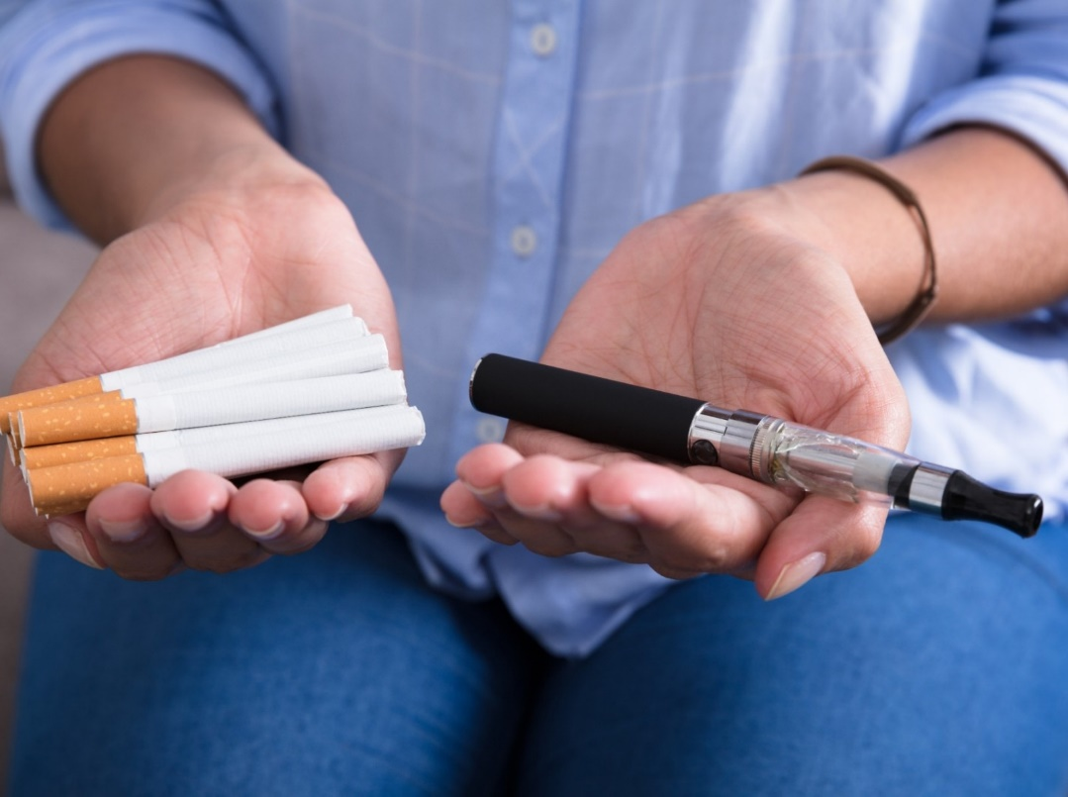
What is drug addiction?
Addiction is an inability to stop using a substance or engaging in a behavior even though it is causing psychological and physical harm.
Nicotine, marijuana and alcohol are commonly misused drugs in today’s world.

Slide 5
Causes
Exposure to a peer group that tolerates or encourages drug abuse
An action performed once as an experiment in a social situation can soon develop into a habit
History of abuse or neglect
Club drugs are commonly being used at clubs, concerts and parties
Easy availability of alcohol and drugs

Slide 6
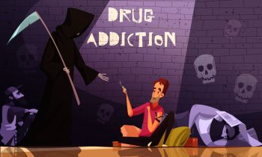
SYMPTOMS OF DRUG ADDICTION
ILL HEALTH
SICKNESS
DISTURBED SLEEP PATTERNS.
HYPERACTIVE

Slide 7

Want to quit but… How?

Slide 8
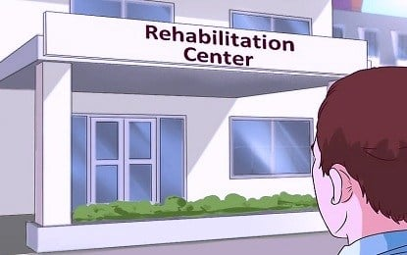
HOPE…
Rehabilitation becomes essential when an individual loses direction into the wrong path and needs to be brought back to the right one.

Slide 9
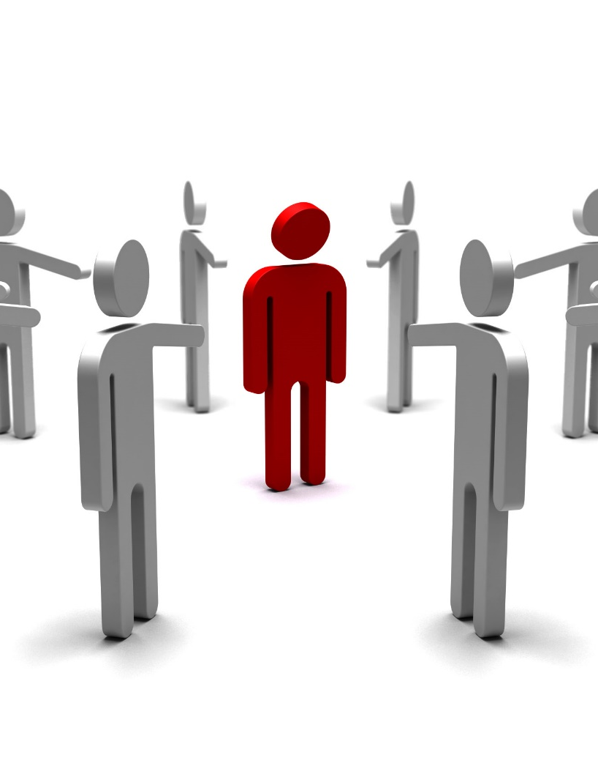
PROBLEM…..!
LOG KYA KAHENGE?
Confidentiality issues
Can not manage time

Slide 10
SOLUTION…

Slide 11
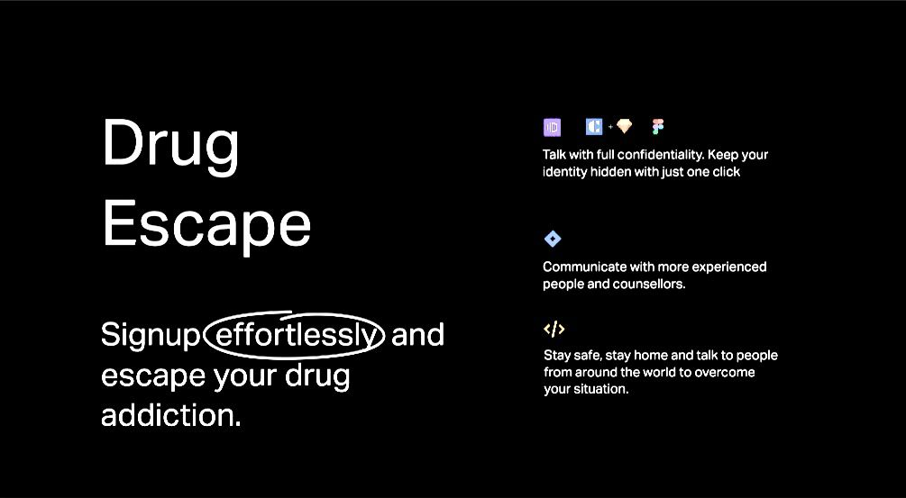

Slide 12
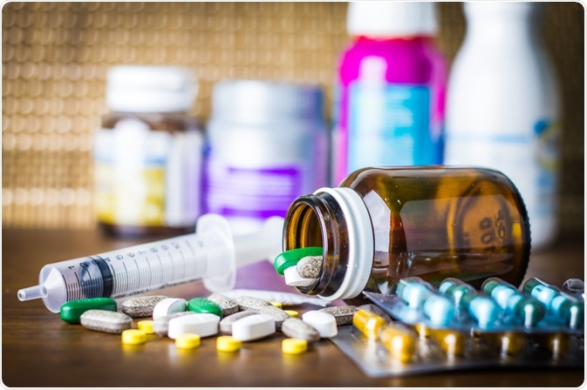
What is DRUG Escape?
Drug escape is an application where people can sign-up and start their journey towards drug escape therapy.

Slide 13
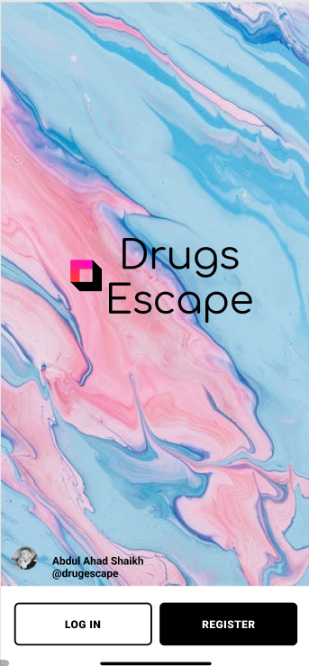
Login PAGE:

Slide 14
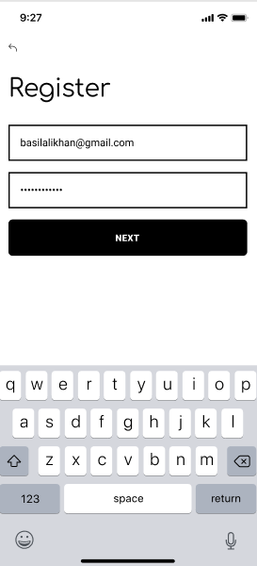
Initially You have to register with the application.

Slide 15
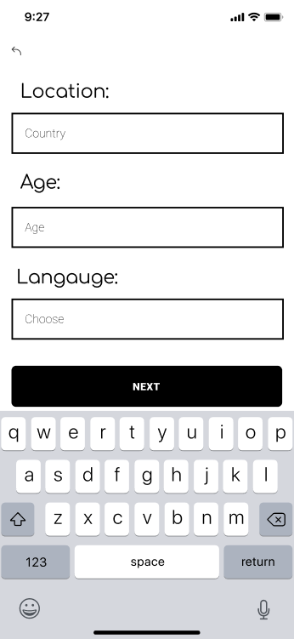
People near you
You are required to enter your location, age and language. The groups that will be created will be broken down age wise and country wise. Language preference is also prioritized.

Slide 16
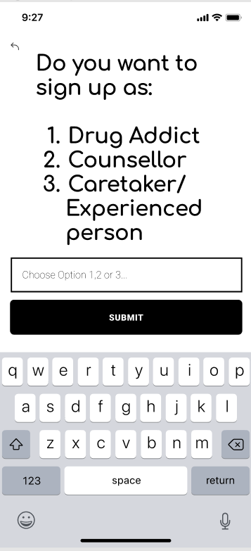
You can Sign Up AS:

Slide 17
OPTION 1: DRUG ADDICT

Slide 18
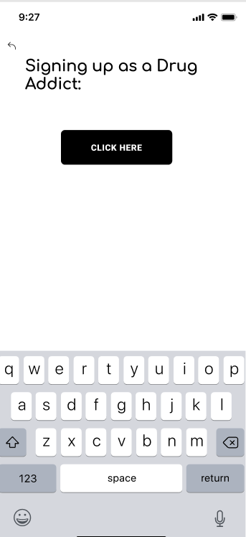
Signing up as A drug ADDICT:
After we press this button, we are directed to a drug scale which will determine the level of the user’s drug addiction.

Slide 19
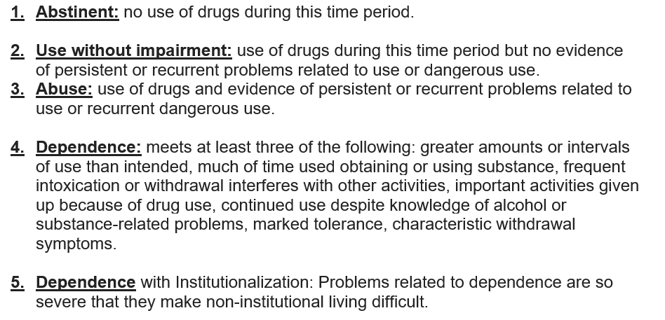
CHOOSE YOUR OPTION:

Slide 20
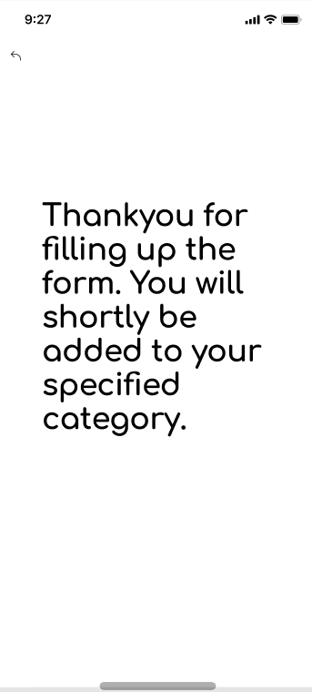
AFTER CHOOSING DRUG SCALE:
The User will then be added to their specified group, according to their age, language, drug scale option and location .

Slide 21
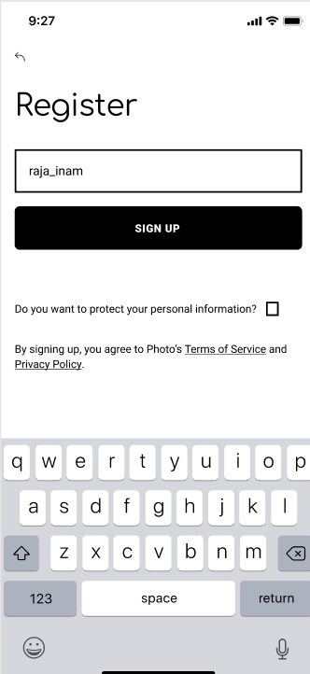
SETTING UP A NICK NAME:
If a user wants to protect their identity, they have an option to join this application using their nickname. Also, If a user wishes to protect their personal information, they have an option to do so.

Slide 22
OPTION 2: COUNSELLOR

Slide 23
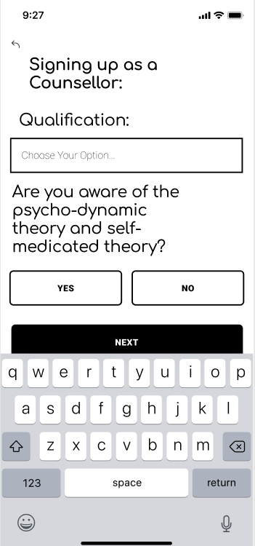
SIGNING UP AS A COUNSELLOR
The Counsellor is asked for qualification, also he/she is guided with the psycho-dynamic theory and the self medication theory if he/she is not already aware of it.

Slide 24
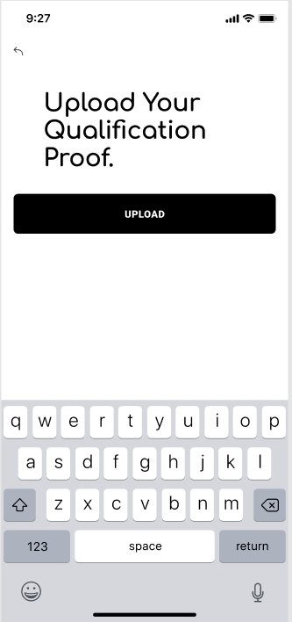
Qualification PROOF

Slide 25
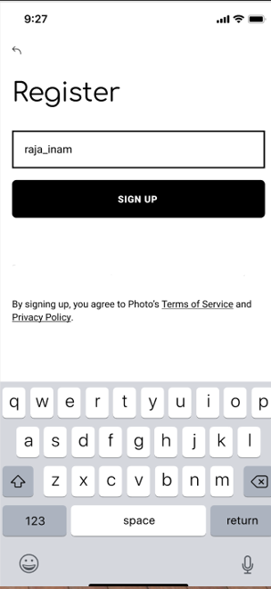
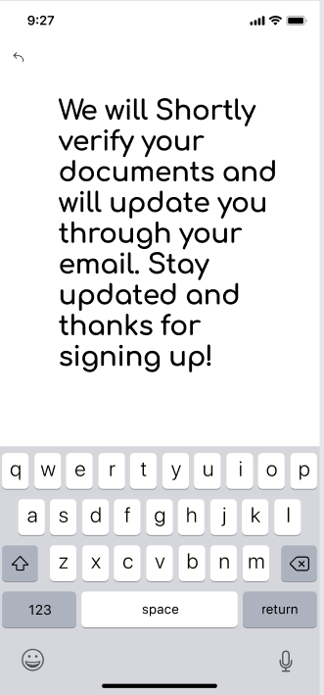

Slide 26
OPTION 3: CARETAKER/EXPERIENCED PERSON

Slide 27
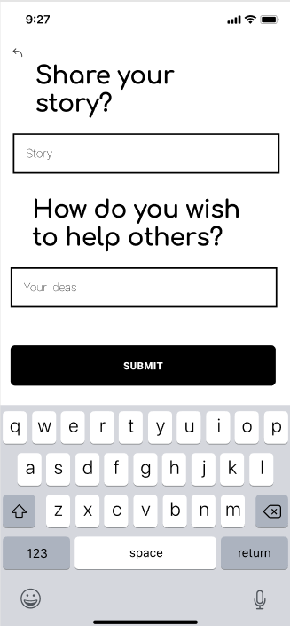
DETAILS

Slide 28
SETTING UP A NICK NAME:
If a user wants to protect their identity, they have an option to join this application using their nickname.

Slide 29
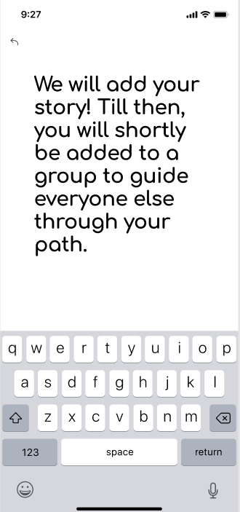
SIGNING Up as a CaReTaker:
They will be added in different groups so that they can guide their journey and motivate others voluntarily!

Slide 30
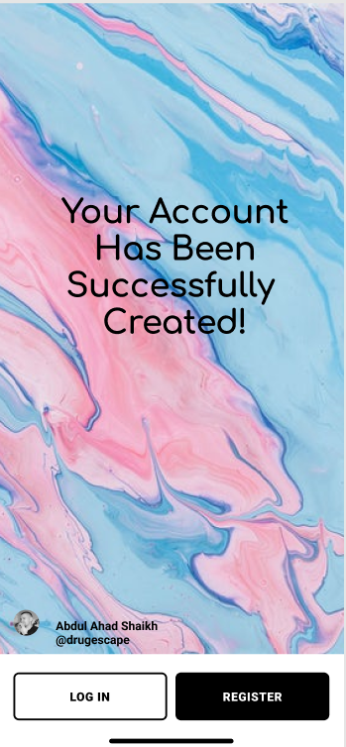
Account Created Just in a Matter OF MINUTES.
Its that EASY!

Slide 31
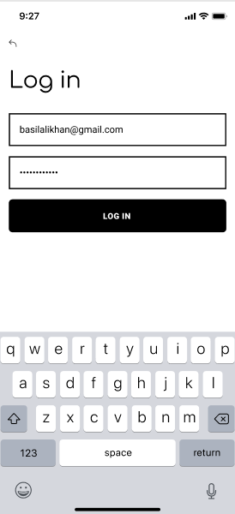
Logging in with the same ID and PASSWORD:

Slide 32
KEY FEATURES OF DRUG ESCAPE

Slide 33
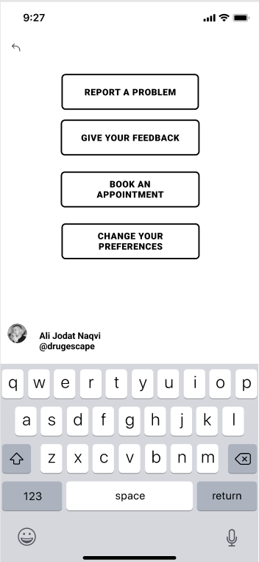
Key Features
Reporting problems
Give your feedback
Book an appointment with a counsellor
Change your preference, such as changing your language etc.

Slide 34
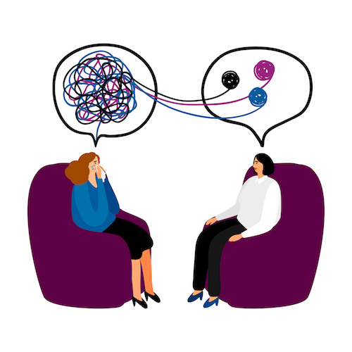
PROCEDURE OF Therapy.
Initial step will be to make them aware that there is a problem with them.
Identify their triggers.
Accept the past and finally move on.
Tell them the benefits of sobriety, and how it is appreciated throughout the world.
Ways to divert their mind, such as morning walk, exercises, and when they are alone, they can talk to new people on our application.

Slide 35
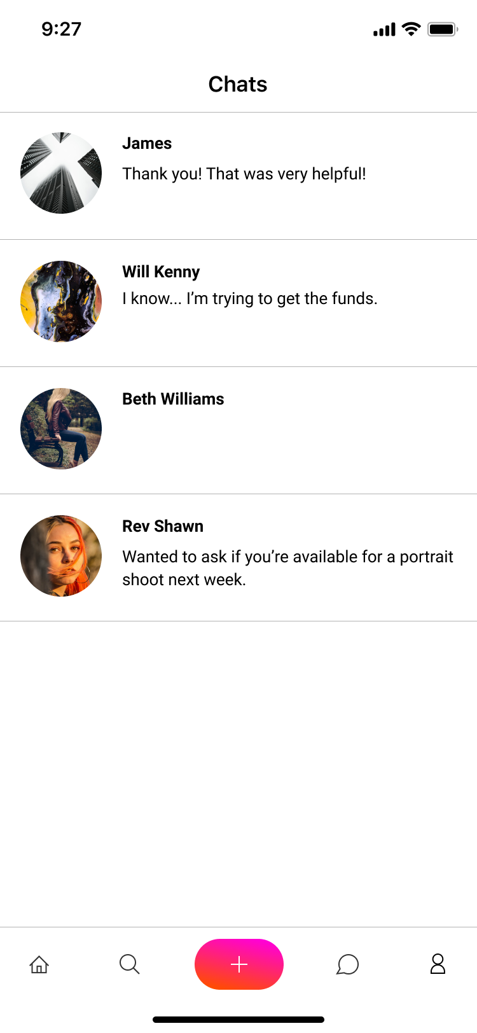
Group conversations
Conversation with sane and sober people could be the best therapy for an addict.
These new friends can help them make new hobbies and also can lead to some productive societal work.

Slide 36
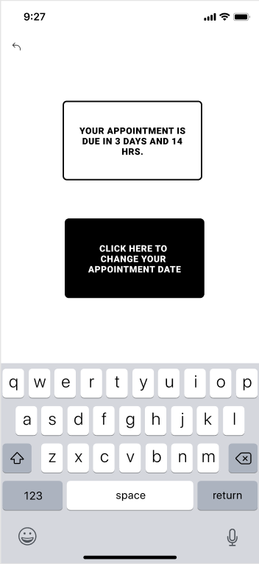
MOTIVATION?
To Keep them motivated, each week an individual based counselling session will be held.

Slide 37
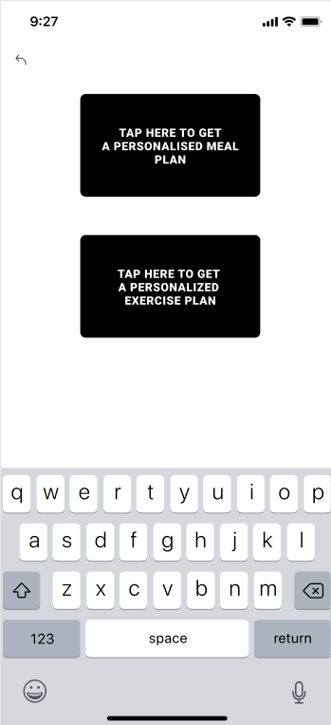
The Connection between Diet & Addiction
Drugs reduce the body’s ability to properly absorb vitamins and minerals. Hence healthy diet and exercise is necessary. Which is why we get our users a personalized meal plan.

Slide 38
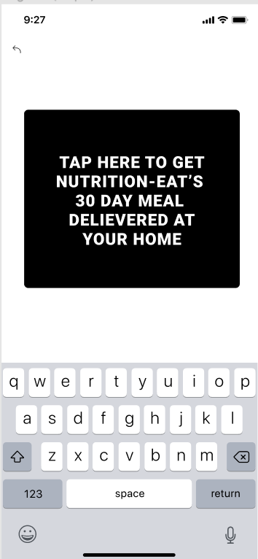
How are we providing personalized meal Plans?
Food companies, such as Nutrition-Eat, who want to promote their company’s name on our application, provide us with personal meal plans for each customer in return of promotional ads such as this one. Also, we pay a small amount to counsellor’s as well to keep them motivated.

Slide 39
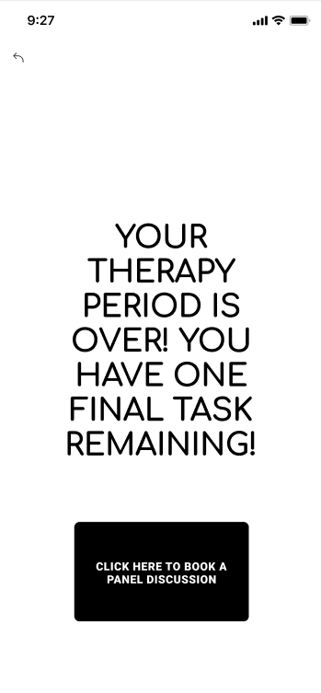
POST THERAPY FEEDBACK:
After the therapy is done, the user has to undertake one final panel discussion in order to complete their therapy. Questions about physical health, diet and exercise routine are asked, as well as the mental health situation.

Slide 40
WHAT HAPPENS AFTER THERAPY?
The drug users can then remain in the app and can view the conversation between counselors and drug users, and they can also serve the users by sharing their experiences. And if they wish to provide feedback or guide someone, they can request by messaging in the chat section and when the message is approved, they can carry out their guidance.
Also, follow up counselling sessions are held after every 3 months in order to keep the ex drug users motivated.

Slide 41

we are evolving
As per our clients feedback, we are consistently evolving and improving our healing or therapy sessions. Usually after every 3-4 months we run improvement procedure on our programs.

Slide 42
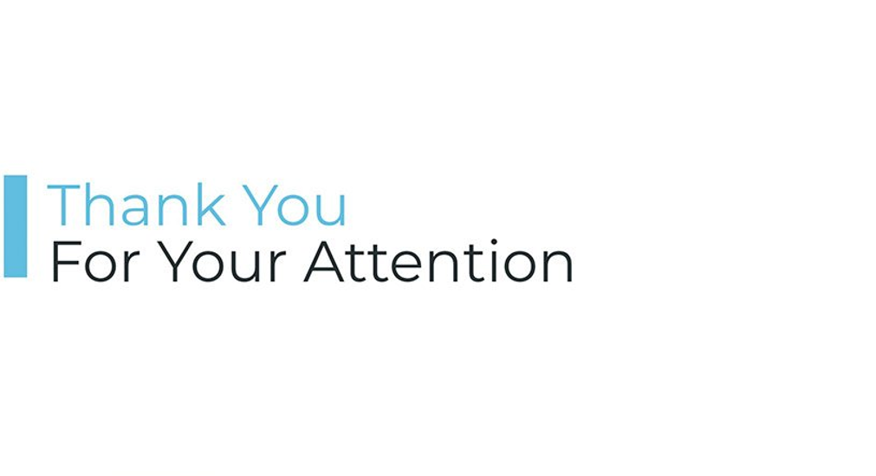

Slide 43


